Slide 1
Maximize Your ISA Membership: ISA Sign Expo Webinar
Unlock full benefits and opportunities through ISA membership
Notes:
---

Slide 2
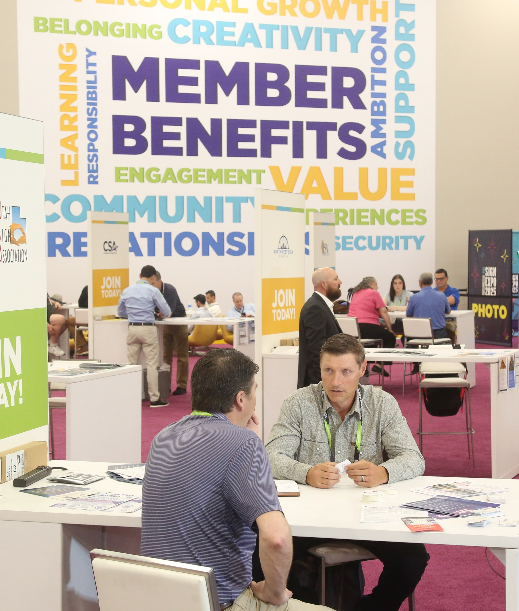

Webinar Goal and Member Value
Planning with Intention
Member Pricing Benefits
Building Peer Connections
Post-Event Follow-Through
Notes:
This webinar is designed to help ISA members get real value from their participation at the ISA Sign Expo. The focus is on practical strategies for planning, leveraging member pricing, building peer connections, and ensuring follow-through after the event. Attendees will learn how ISA membership supports return on investment before, during, and after Expo, making the experience more intentional and impactful.

Slide 3
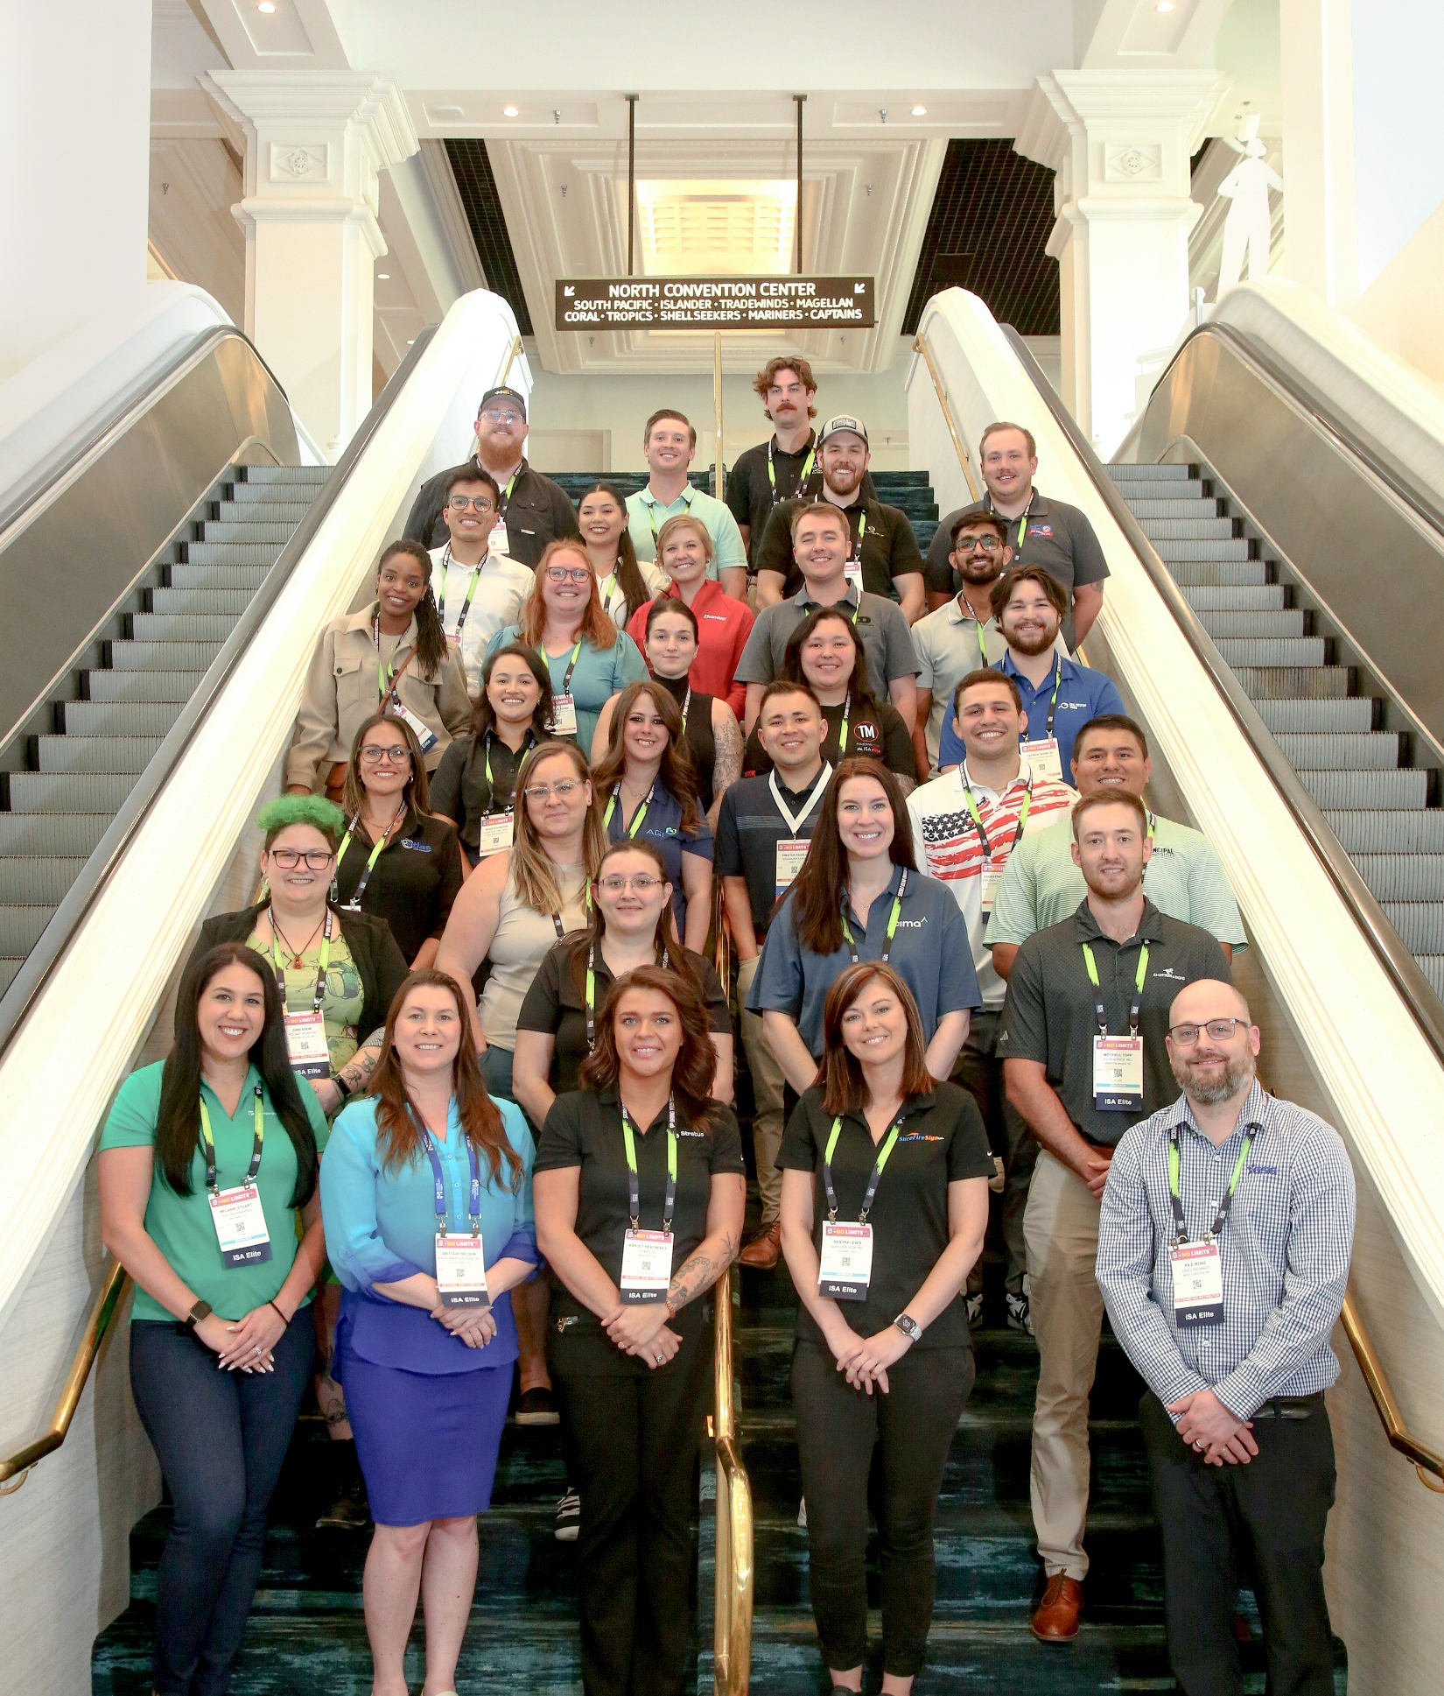
Intentional Planning for Expo Success
Early Commitment
Benefits of Intentional Planning
Member Discounts Encourage Maximizing Expo Value
Notes:
Expo is a large event and can be overwhelming without a clear plan. Early commitment and intentional planning reduce stress and help attendees focus on what matters most. Member discounts make it easier to commit and plan ahead, ensuring participants leave with actionable ideas and tangible value. The goal is to maximize the time spent at Expo and return with insights that can be applied to daily operations.

Slide 4
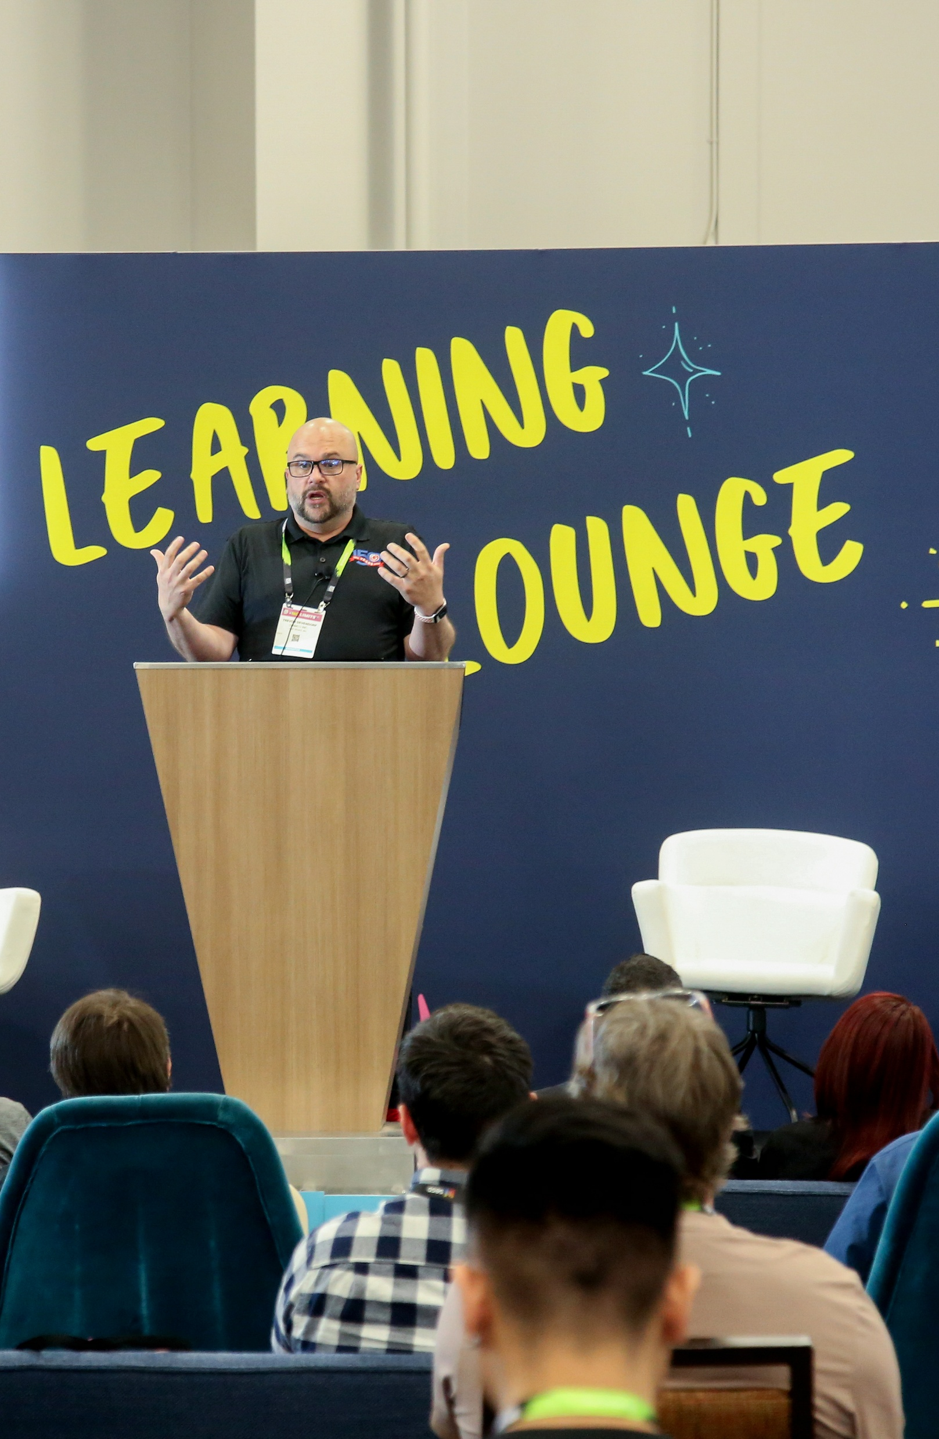
Member Pricing Enables Confidence and Participation
Reduces Hesitation
Encourages Full Participation
Protects Investment
Notes:
Member pricing reduces hesitation and makes it easier to justify the investment of attending Expo. It enables fuller participation in education and events, allowing members to take advantage of opportunities they might otherwise skip. By protecting the Expo investment, member pricing helps attendees commit with confidence and ensures they get the most out of their experience.

Slide 5

Peer Connections Deliver Real Value
Show-floor Conversations Transform
Formal and Informal Discussions
Unique Member Connections
Notes:
The most valuable conversations at Expo often happen off the main stage, in informal settings and focused discussions. Show-floor conversations turn questions into solutions, while roundtables and Spark Sessions make Expo feel more approachable and personal. Peer connections provide perspectives and insights that members cannot get elsewhere, helping them solve challenges and discover new opportunities.

Slide 6
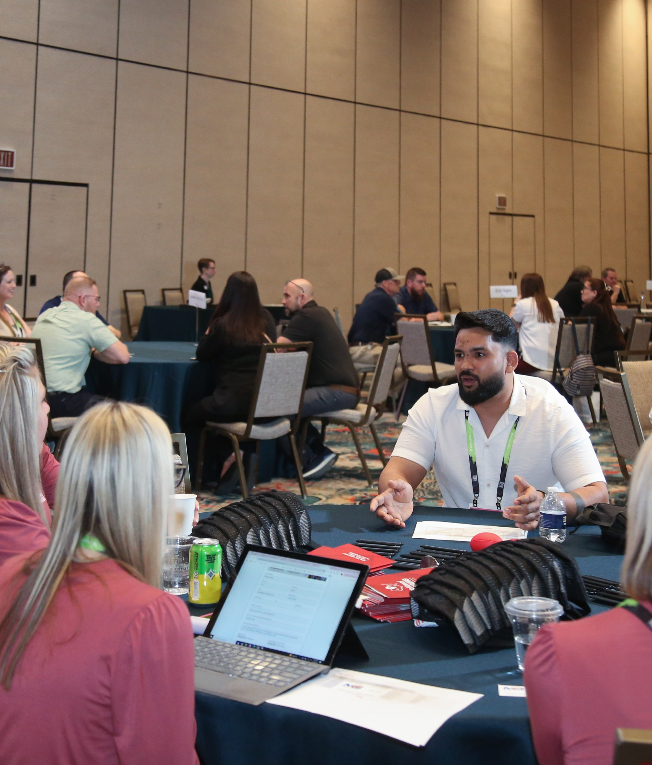
Turning Expo Insights into Action
Importance of Follow-Through
Ongoing Conversations
Turning Inspiration into Results
Learning, Workforce & Advocacy Support
Notes:
While Expo generates energy and ideas, real value comes from follow-through. Sharing insights, testing new ideas, and staying connected with peers ensures that the momentum continues after the event. ISA supports ongoing learning and engagement through education, roundtables, and peer-led discussions, helping members turn Expo inspiration into practical results.

Slide 7
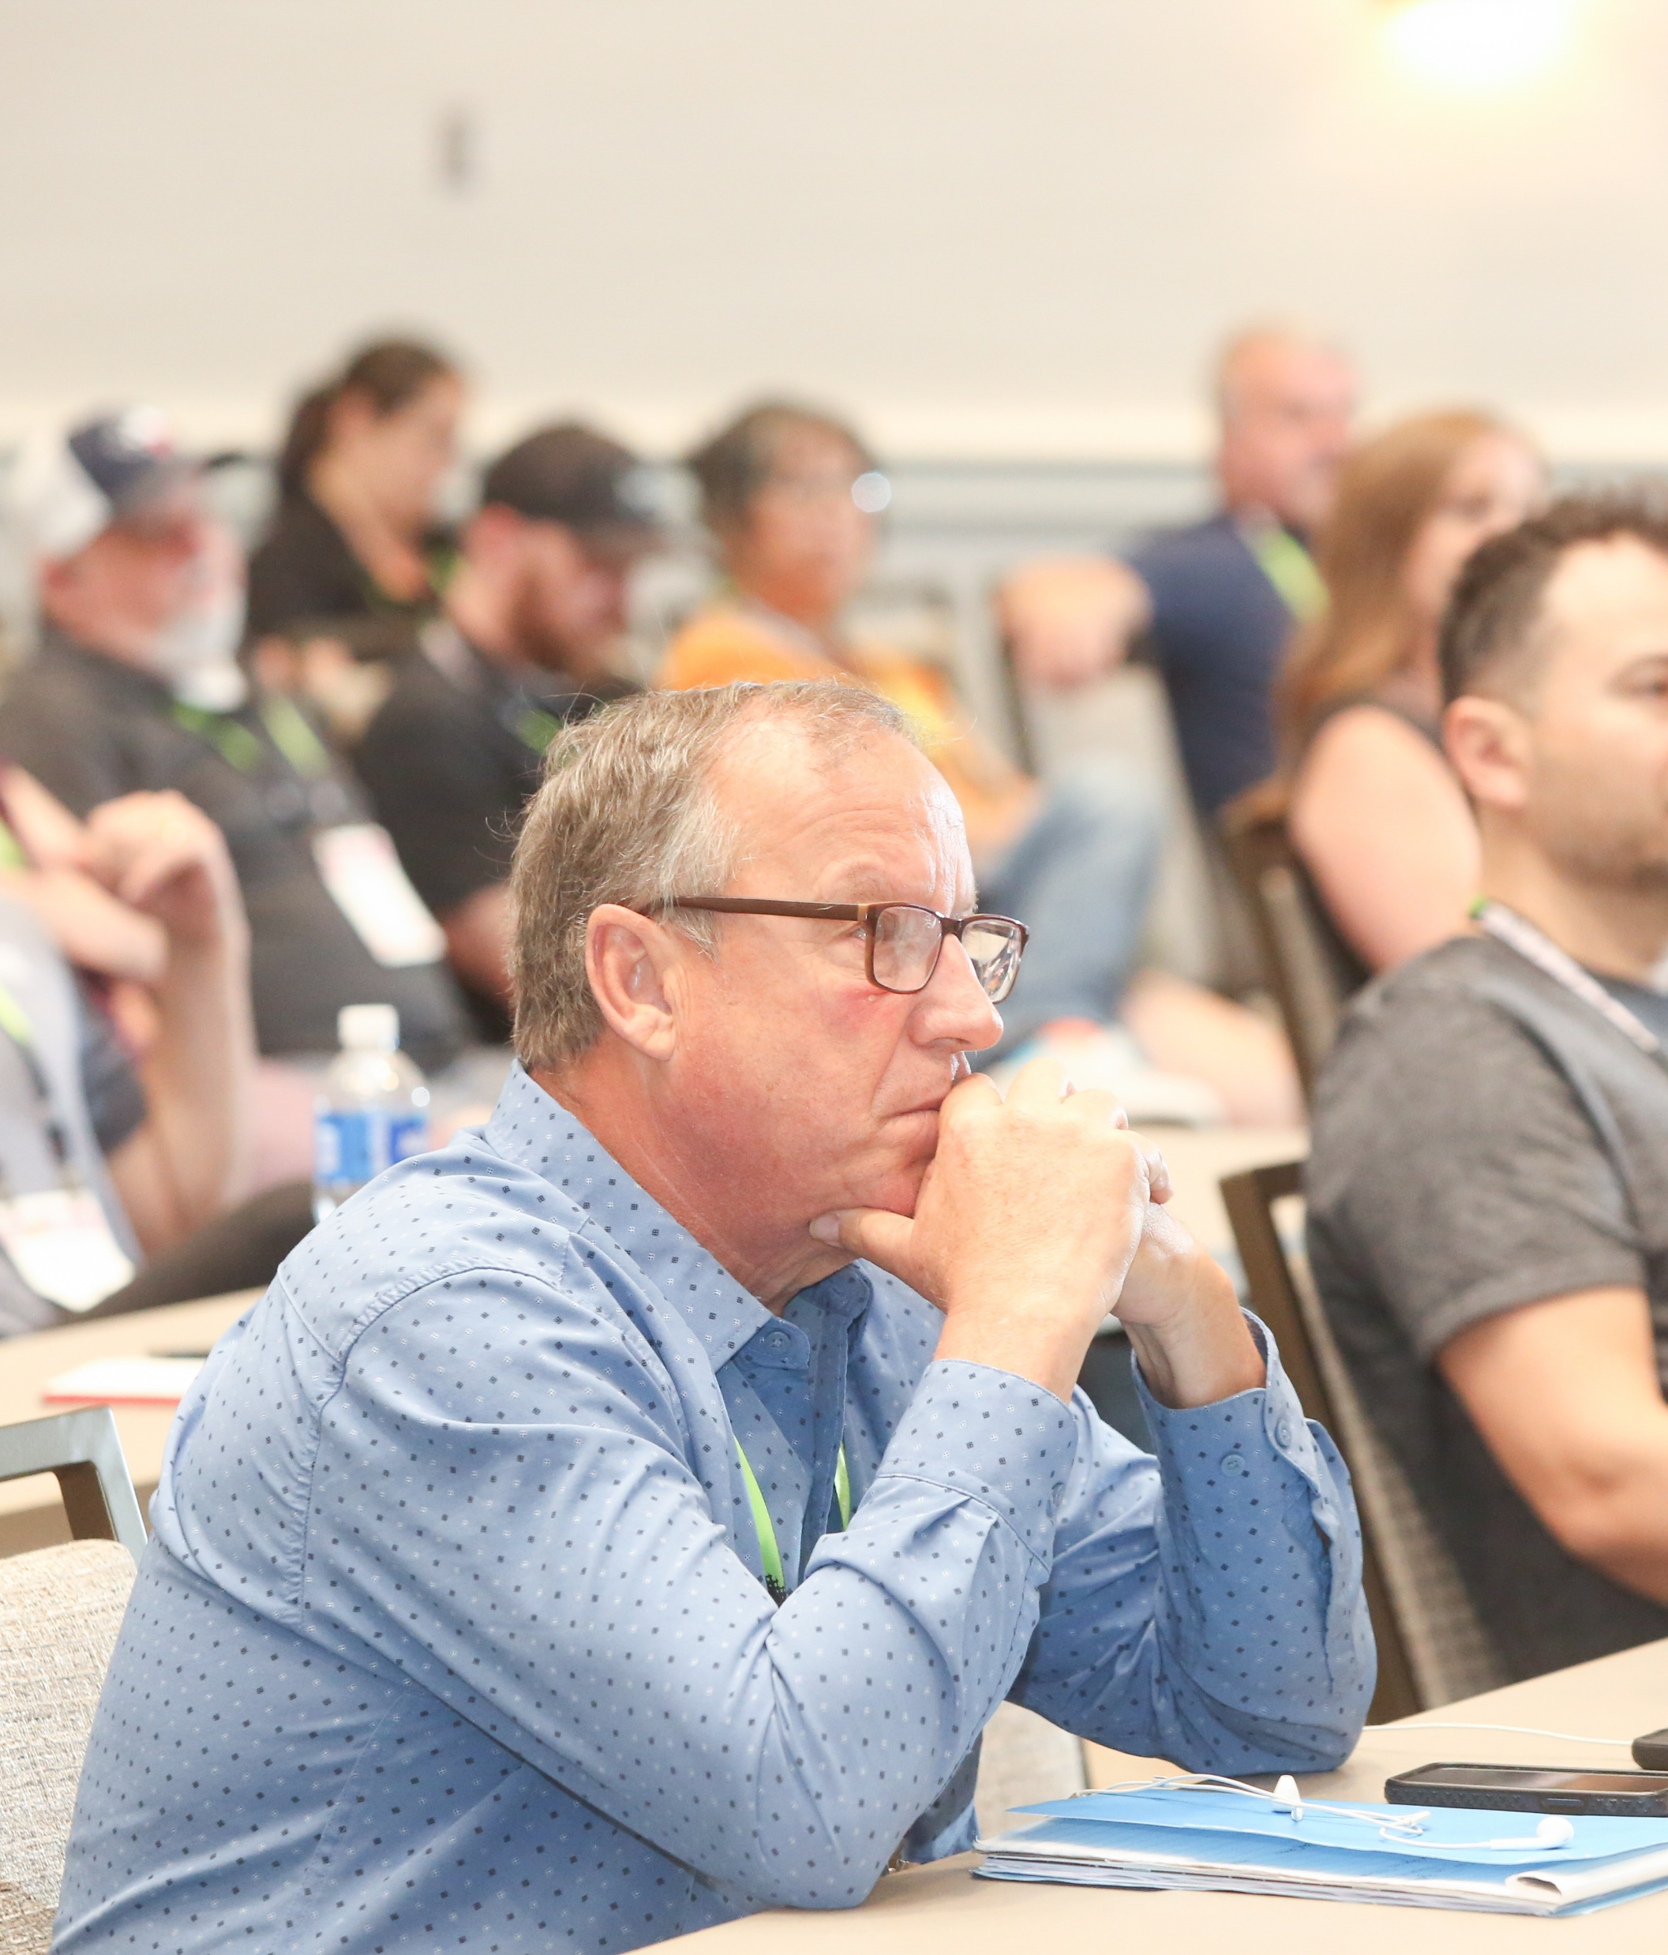
Maximize Your ISA Membership: ISA Sign Expo
Plan for Success
Utilize Member Pricing
Leverage Peer Connections
Turning Sparks into Returns
Notes:
To maximize your ISA membership at Expo, plan ahead to protect your time, use member pricing to commit with confidence, and leverage peer connections for perspective. Expo gives you the spark—what you do before, during, and after creates the return. Being intentional throughout the process ensures you get the most value from your membership and Expo experience.

